Slide 1
Tetris
CS 155
Final Project
By Angel Tapia

Slide 2
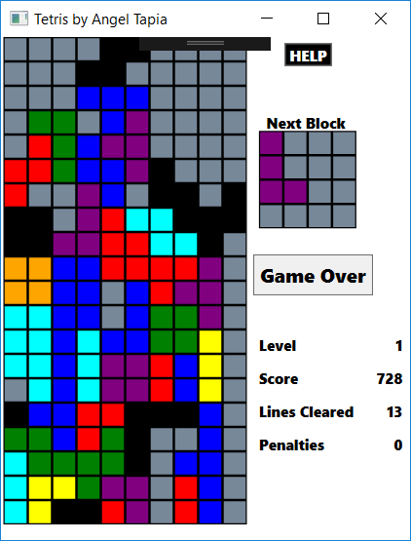
Game
10 Levels each at 500 score
10 scores per cleared line
1 score per step in fast drop
-5 score for each move up

Slide 3
Challenges
#Views cannot be extended (Sealed classes)
Solution: Wrapper class TetrisCell
//Tetris cells properties
public Rectangle Cell { get; set; }
public int ID { get; set; }
#Audio Manipulation External library too complicated for a simpleTetris Game.
Solution: multiple audio files Adobe Audition
SoundPlayer audio = new SoundPlayer(audioPath)
audio.PlayLooping();

Slide 4
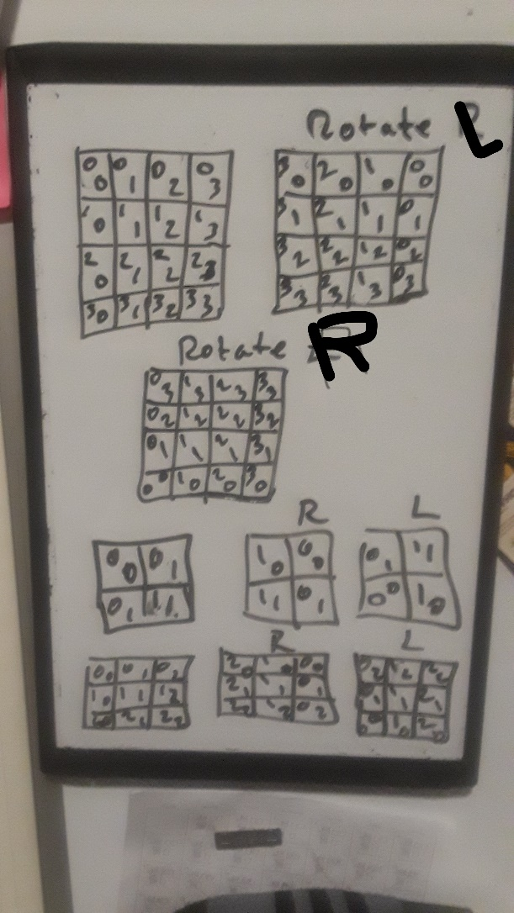
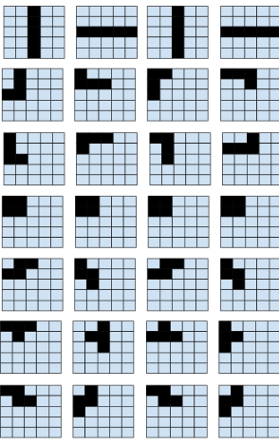
Brief Design of program
TetrisCell
-in cellId
-Rectamgle cell
-SolidColorBrushCellColor
+ bool IsEmpty()
TetrisBlock
-cellId
-CellColor
-bool PaintBlock(int, int)
+int[,] CopyBlock()
+bool Move(int, int)
+bool Rotate()
Tetris
-TetrisBlock currentBlock
- TetrisBlock nextBlock
+int ClearRow
+bool Spawn
+bool Move(int, int)
+void Reset
TetrisBlock
- Tetris tetris
-DispatcherTimer dt_timer;
-void Dt_Tick(object,EventArgs )
-void Window_KeyDown(object , KeyEventArgs)

Slide 5
Demonstration

